Slide 1
Capstone Engagement
Assessment, Analysis, and Hardening of a Vulnerable System

Slide 2
Table of Contents
This document contains the following sections:
Network Topology
1
2
Red Team: Security Assessment
3
Blue Team: Log Analysis and Attack Characterization
Hardening: Proposed Alarms and Mitigation Strategies
4

Slide 3
Network Topology

Slide 4
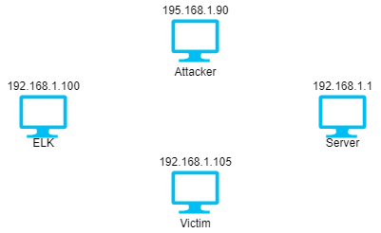
Network Topology
Network
Address Range:
Netmask:
Gateway:
Machines
IPv4: 192.168.1.1
OS: Windows XP/7/Server 2008
Hostname: ML-RefVm-684427
IPv4: 192.168.1.100
OS: Ubuntu
Hostname: Unknown
IPv4: 192.168.1.105
OS: Ubuntu
Hostname: Unknown
IPv4: 192.168.1.90
OS: Kali
Hostname: root

Slide 5

Red Team
Security Assessment

Slide 6
Recon: Describing the Target
Nmap identified the following hosts on the network:
Hostname | IP Address | Role on Network
ML-RefVm-684427 | 192.168.1.1 | Server
Could not be resolved | 192.168.1.100 | ELK
Could not be resolved | 192.168.1.105 | Victim
root | 192.168.1.90 | Attacker

Slide 7
Vulnerability Assessment
The assessment uncovered the following critical vulnerabilities in the target:
Vulnerability | Description | Impact
Reverse PHP meterpreter shell | When a malicious PHP file was uploaded to the share folder a reverse PHP meterpreter session can be established | Access to sensitive files
Confidential information disclosed openly on the website | Information in the section of the website about team members disclosed compromising information that lead to the discovery of usernames and passwords | Access to unintentional directories and the webdav server
Weak passwords | Weak hashed passwords were able to be cracked in minimal amounts of time | Compromise of sensitive directories and systems

Slide 8
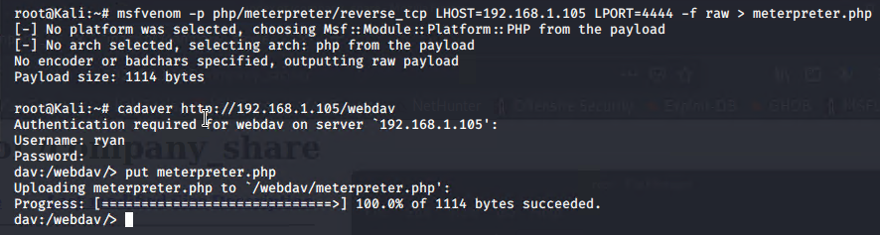
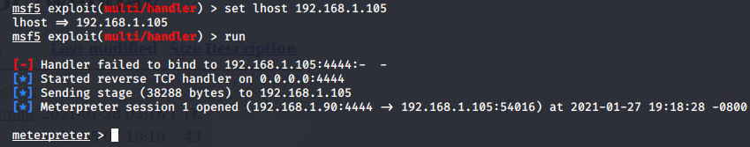
Exploitation: Reverse PHP meterpreter shell
Tools & Processes
Msfvenom to create a malicious PHP file, cadaver to upload the file, and metasploit to execute the exploit
Achievements
I was able to gain a meterpreter shell into the system

Slide 9
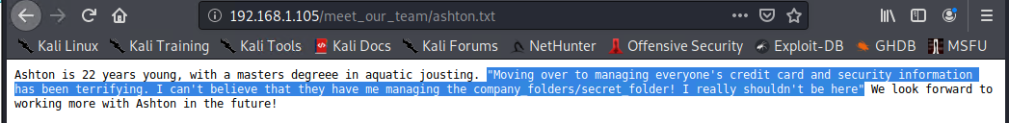
Exploitation: Confidential information disclosed openly on the website
Tools & Processes
When poking around the website, under Ashton’s “about me” info there was an unintentional line mentioning the secret_folders directory and that Ashton managed it
Achievements
This information lead to discovering that the secret folder needed Ashton’s credentials to access

Slide 10
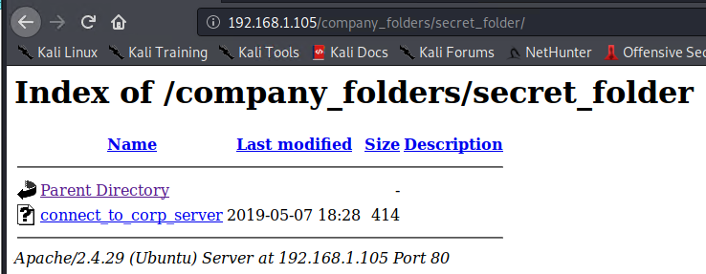

Exploitation: Weak passwords
Tools & Processes
Hydra was used to brute force Ashton’s login to the secret folder where Ryan’s hashed password was found and easily cracked with Crackstation.net
Achievements
Gaining access to the secret folder and finding instructions to connect to the webdav server as well as Ryan’s login info allowed the upload of a malicious PHP file to gain a reverse shell

Slide 11

Blue Team
Log Analysis and
Attack Characterization

Slide 12
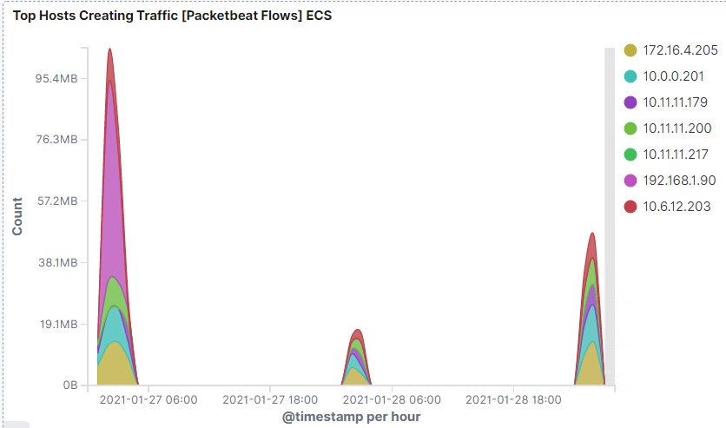
Analysis: Identifying the Port Scan
The scan occurred at ~0300 on January 27th
When filtering for the top 1000 destination ports there is a spike from IP address 192.168.1.90 (Attacker machine)

Slide 13
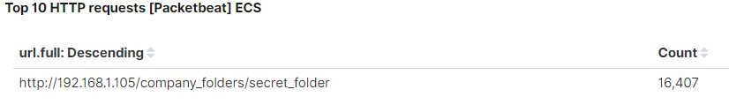
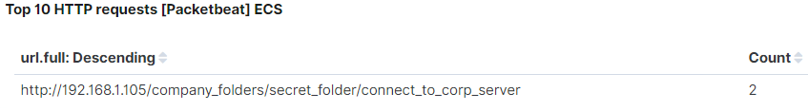
Analysis: Finding the Request for the Hidden Directory
A spike in requests for the secret folder occurred at ~0300 on February 27th with a count surpassing 16,000
The connect_to_corp_server file was successfully accessed twice which contained instructions to connect to the webdav server

Slide 14
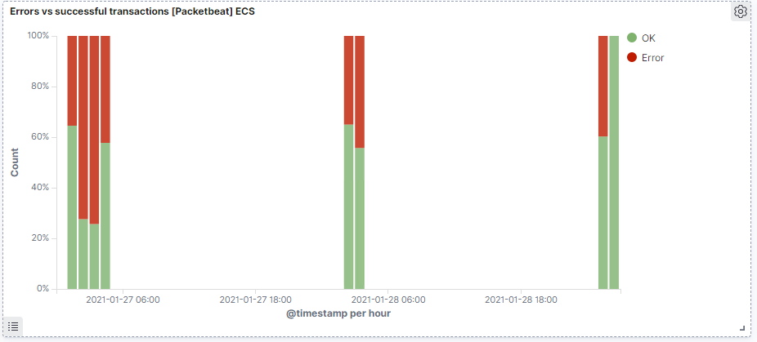
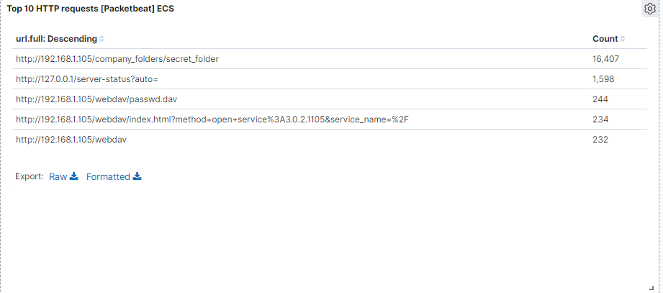
Analysis: Uncovering the Brute Force Attack
In the brute force attack on the secret folder there were 16,407 requests made
Out of these there were two successful connections to access the content, so there were 16,405 attempts before success

Slide 15
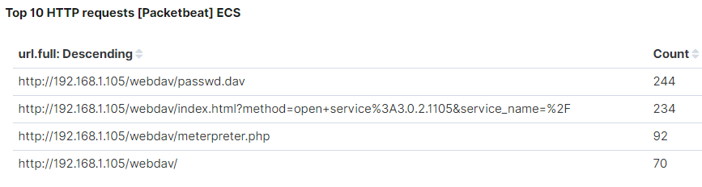
Analysis: Finding the WebDAV Connection
There were 640 requests for different assets associated with the webdav server
Files requested included passwd.dav, index.html, and meterpreter.php

Slide 16
Blue Team
Proposed Alarms and
Mitigation Strategies

Slide 17
Mitigation: Blocking the Port Scan
What kind of alarm could be set to mitigate this, and what is the threshold? To detect future port scans an alert could be created to trip if there is a high number of different destination port connections within the top 1000. My suggested threshold for the alert would be if 25 of the top 1000 ports are scanned within a 5 minute period, alert the SOC
What configurations can be set on the host to mitigate port scans? Conduct an internal port scan and determine which ones are actually needed, whitelist IP addresses to connect to certain ports, get a firewall that can detect and prevent port scans, or use TCP wrappers to set which IP’s or domains are blocked.

Slide 18
Mitigation: Finding the Request for the Hidden Directory
What kind of alarm can be set to detect future unauthorized access and what would the threshold be? An alert could be created to trip if a certain number of connections was made within a short time period. Since there are not many employees trying to access this I would set the alert to trip of there were more than 10 requests in a 5 minute period
What configuration can be set on the host to block unwanted access? Create an IP whitelist for connections and take down public facing information pointing towards the directory

Slide 19
Mitigation: Preventing Brute Force Attacks
What kind of alarm can be set to detect future brute force attacks and what would the threshold be? If a certain threshold of POST requests is surpassed an alert will trip. My suggestion is to set this threshold to 200
What configuration can be set on the host to block brute force attacks? I would suggest to set a firewall rule to block an IP address if there is an unusual amount of POST requests coming from it

Slide 20
Mitigation: Detecting the WebDAV Connection
What kind of alarm can be set to detect future access to this directory? If an unusual amount of traffic from a single IP address is connecting to the webdav server, send an alert. I would set the threshold to 20 connections
What configuration can be set on the host to control access? Have a whitelist of IP addresses allowed to connect and use complex passwords mixed with 2 factor authenication

Slide 21
Mitigation: Identifying Reverse Shell Uploads
What kind of alarm can be set to detect future file uploads? Set an alert for any certain types of files uploaded, in this case PHP
What configuration can be set on the host to block file uploads? Restrict the types of files that can be uploaded and have antivirus scan every file that is uploaded

